Slide 1
Data Warehousing
T V Rao, BITS, Pilani (off-campus)
M6: OLAP & Multidimensional Databases (MDDB)

Slide 2
Multidimensional Databases

Slide 3
Why Multidimensional Database
In 1960s, when a research scholar at MIT was doing analytical work on product sales, he realized that
he spent most of his time wrestling with reformatting the data for his analysis,
not on the statistical algorithms or the true data analysis
Once he had modeled the data in a multidimensional form, he was able to report the data in many different formats
By abstracting the data model from the data itself, the user could work with the data in an ad hoc fashion, asking questions that had not been formulated when developing the specifications

Slide 4
Multidimensional Database
A multidimensional database, or MDB, stores dimensional information in a format called a cube.
The basic concept of a cube is to precompute the various combinations of dimension values and fact values so they can be studied interactively
Data in an MDB is accessed through an interface, which is often proprietary, although MDX (MultiDimensionalEXpressions) has gained wide acceptance as a standard
MDBs support many statistical functions

Slide 5
A Motivating Example
An automobile manufacturer wants to increase sale volumes by examining sales data collected throughout the organization. The evaluation would require viewing historical sales volume figures from multiple dimensions such as
Sales volume by model
Sales volume by color
Sales volume by dealer
Sales volume over time

Slide 6
Sales Data in Relational Form
MODEL | COLOR | SALES VOLUME
Hatchback | BLUE | 6
Hatchback | RED | 5
Hatchback | WHITE | 4
SUV | BLUE | 3
SUV | RED | 5
SUV | WHITE | 5
SEDAN | BLUE | 4
SEDAN | RED | 3
SEDAN | WHITE | 2

Slide 7
Multidimensional Structure
Measurement
Dimension
MODEL
6 | 5 | 4
3 | 5 | 5
4 | 3 | 2
Hatchback
SUV
Sedan
Blue
Red
White
Positions
COLOR
Dimension

Slide 8
Comments on Multidimensional Structure
The relational structure tells us nothing about the possible contents of those fields.
The structure of the array, on the other hand, tells us not only that there are two dimensions, COLOR and MODEL, but it also presents all possible values of each dimension as positions along the dimension.
Because of this structured presentation, all possible combinations of perspectives containing a specific attribute (the color BLUE, for example) line up along the dimension position for that attribute.
This makes data browsing and manipulation highly intuitive to the end-user. As a result, this "intelligent" array structure lends itself very well to data analysis.

Slide 9
Let us add Dealer to the table
MODEL | COLOR | DEALERSHIP | VOLUME
Hatchback | BLUE | Mitra | 6
Hatchback | BLUE | Patel | 6
Hatchback | BLUE | Singh | 2
Hatchback | RED | Mitra | 3
Hatchback | RED | Patel | 5
Hatchback | RED | Singh | 5
Hatchback | WHITE | Mitra | 2
Hatchback | WHITE | Patel | 4
Hatchback | WHITE | Singh | 3
SUV | BLUE | Mitra | 2
SUV | BLUE | Patel | 3
SUV | BLUE | Singh | 2
SUV | RED | Mitra | 7
SUV | RED | Patel | 5
SUV | RED | Singh | 2
SUV | WHITE | Mitra | 4
SUV | WHITE | Patel | 5
SUV | WHITE | Singh | 1
SEDAN | BLUE | Mitra | 6
SEDAN | BLUE | Patel | 4
SEDAN | BLUE | Singh | 2
SEDAN | RED | Mitra | 1
SEDAN | RED | Patel | 3
SEDAN | RED | Singh | 4
SEDAN | WHITE | Mitra | 2
SEDAN | WHITE | Patel | 2
SEDAN | WHITE | Singh | 3

Slide 10
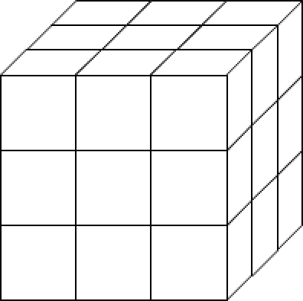
Multidimensional Structure
MODEL
Hatchback
2
5
3
SUV
n
n
n
Sedan
Mitra
n
n
n
Patel
Singh
DEALER
Blue
Red
White
COLOR

Slide 12
Performance Advantages with MDB
Volume figure when car type = SEDAN, color=BLUE, & dealer=PATEL?
RDBMS – all 1000 records might need to be searched to find the right record
MDB has more ‘knowledge’ about where the data lies
Maximum of 30 position searches
Average case
MDB 15 vs. 500 for RDBMS

Slide 13
Performance Advantages with MDB
To generalize the performance advantage
In case of RDBMS, size of search space gets multiplied, each time a new dimension is added; accordingly access time is affected
In case of MDB, the search space increases by the size of new dimension, each time a new dimension is added.
At what cost?
MDB is a separate proprietary implementation from SQL
Since all business data is in RDBMS, the MDB has to be precomputed. Larger the data, more the dimensions, higher the precomputation effort.
Higher the interval of precomputation, higher the latency in MDB

Slide 14
OLAP Operations
Roll up (drill-up): summarize data
by climbing up hierarchy or by dimension reduction
Drill down (roll down): reverse of roll-up
from higher level summary to lower level summary or detailed data, or introducing new dimensions
Slice and dice: project and select
Pivot (rotate):
reorient the cube, visualization, 3D to series of 2D planes
Other operations
drill across: involving (across) more than one fact table
drill through: through the bottom level of the cube to its back-end relational tables (using SQL)

Slide 15
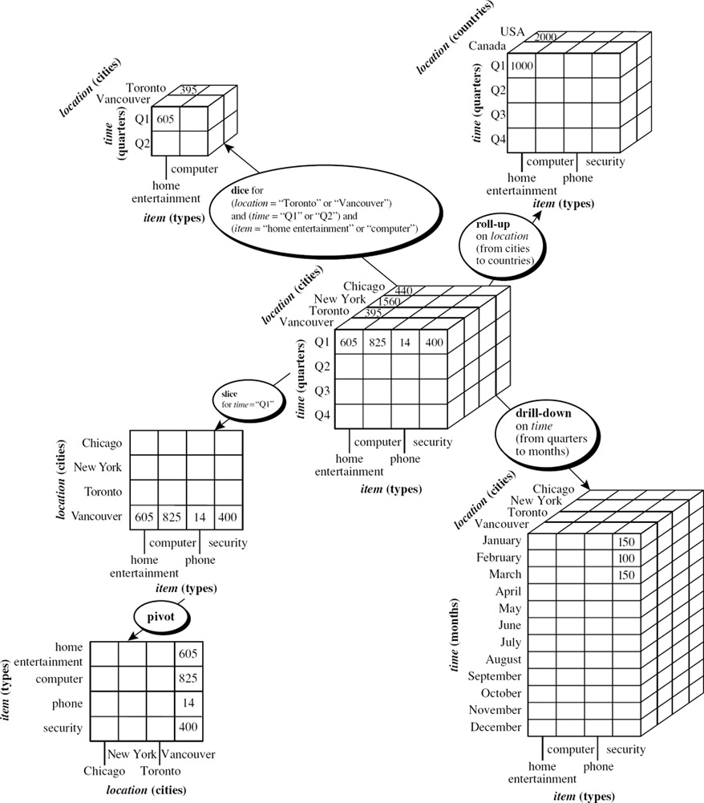
OLAP Operations

Slide 16
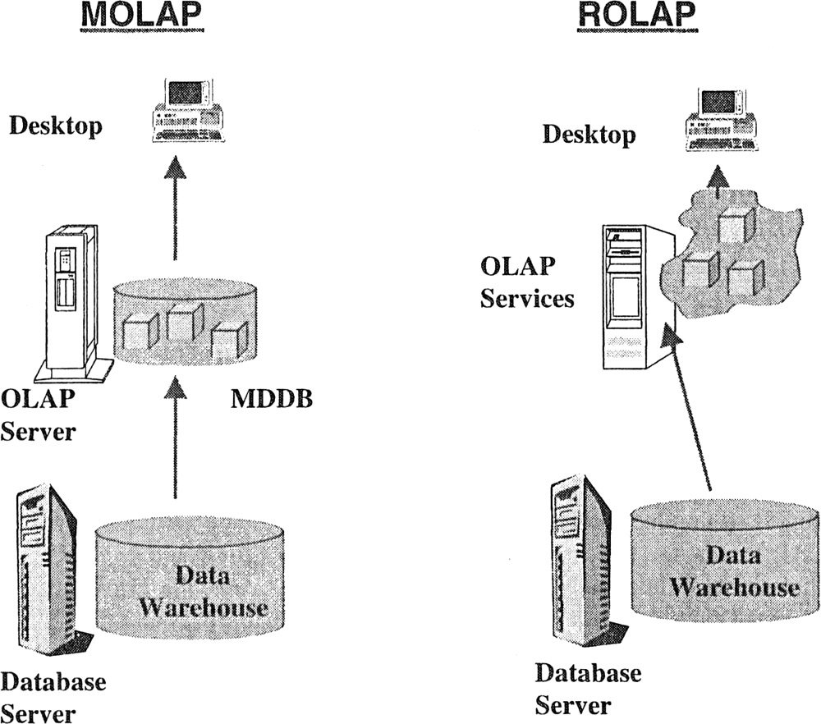
Distinct OLAP models

Slide 17
Data Storage
ROLAP | MOLAP
Data stored as relational tables in the warehouse. Detailed and light summary data available. Very large data volumes. All data access from the warehouse storage. | Data stored as relational tables in the warehouse. Various summary data kept in proprietary databases (MDBs) Moderate data volumes. Summary data access from MDB, detailed data access from warehouse.

Slide 18
Underlying Technologies
ROLAP | MOLAP
Use of complex SQL to fetch data from warehouse. ROLAP engine in analytical server creates data cubes on the fly. Multidimensional views by presentation layer. | Creation of pre-fabricated data cubes by MOLAP engine. Proprietary technology to store multidimensional views in arrays, not tables. High speed matrix data retrieval. Sparse matrix technology to manage data sparsity in summaries.

Slide 19
Functions and Features
ROLAP | MOLAP
Known environment and availability of many tools. Limitations on complex analysis functions. Drill-through to lowest level easier. Drill-across not always easy. | Faster access. Large library of functions for complex calculations. Easy analysis irrespective of the number of dimensions. Extensive drill-down and slice-and-dice capabilities.

Slide 20
HOLAP (Hybrid OLAP)
The intermediate architecture type, HOLAP, aims at mixing the advantages of both basic solutions. It takes advantage of the standardization level and the ability to manage large amounts of data from ROLAP implementations, and the query speed typical of MOLAP systems. HOLAP has the largest amount of data stored in an RDBMS, and a multidimensional system stores only the information users most frequently need to access. If that information is not enough to solve queries, the system will transparently access the part of the data managed by the relational system. Important market actors have adopted HOLAP solutions to improve their platform performance.

Slide 21
Prescribed Text Books
 | Author(s), Title, Edition, Publishing House
T1 | Ponniah P, “Data Warehousing Fundamentals”, Wiley Student Edition, 2012
T2 | Kimball R, “The Data Warehouse Toolkit”, 3e, John Wiley, 2013
References
 | Author(s), Title, Edition, Publishing House
 | Star Schema: The Complete Reference by Christopher Adamson McGraw-Hill/Osborne Kenan Technologies, An introduction to Multidimensional Database Technology Data Mining: Concepts and Techniques, Third Edition by Jiawei Han, Micheline Kamber and Jian Pei Morgan Kaufmann Publishers

Slide 22
Thank You

